Slide 1
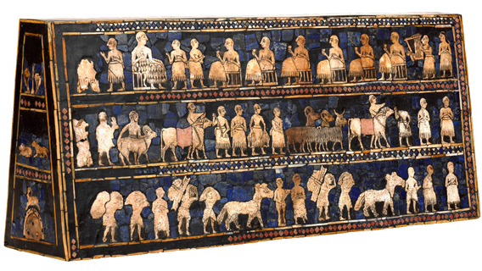
Artefact 1 - Mesopotamia

Slide 2
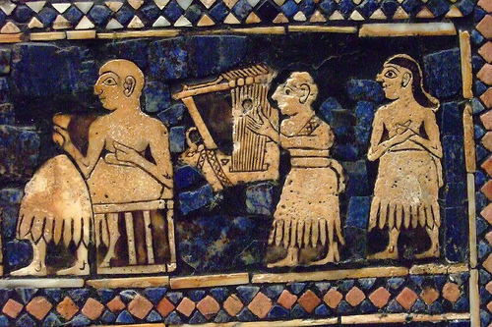
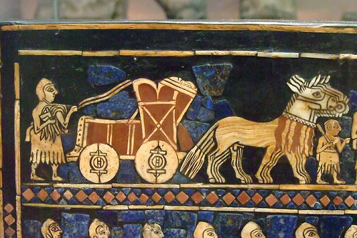
ARTEFACT 1 (Mesopotamia) -Details (close ups) from artefact:

Slide 3
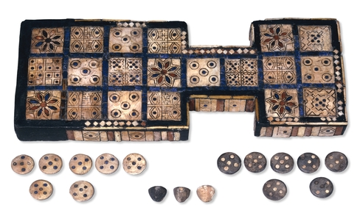
Artefact 2 - Mesopotamia

Slide 4
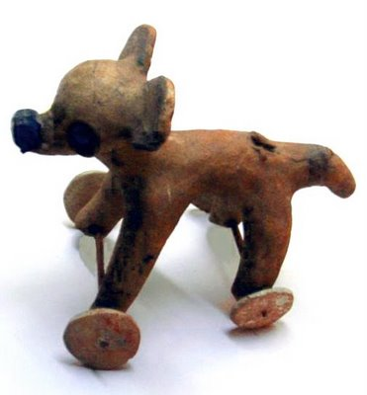
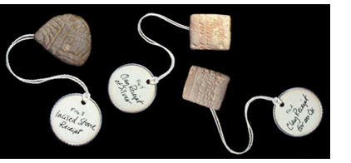
Artefact 3 - Mesopotamia

Slide 5
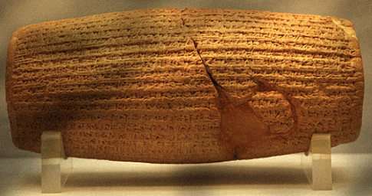
Artefact 4 - Mesopotamia

Slide 6
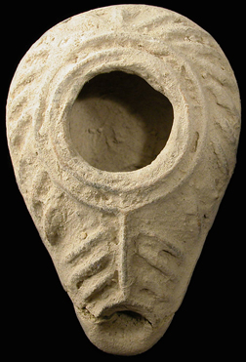
Artefact 5 - Mesopotamia

Slide 7
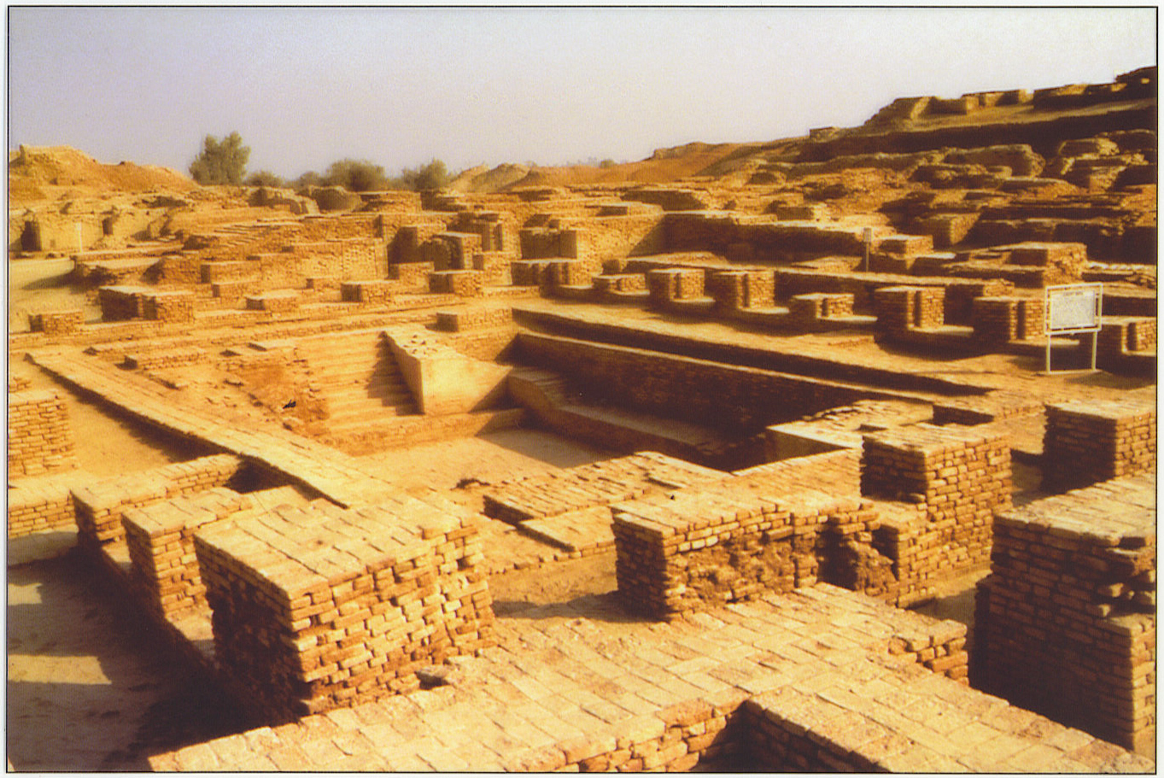
Artefact 6 - India

Slide 8
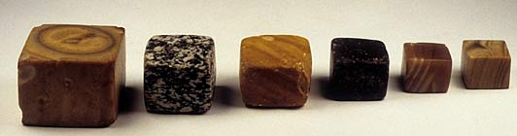
Artefact 7 - India

Slide 9
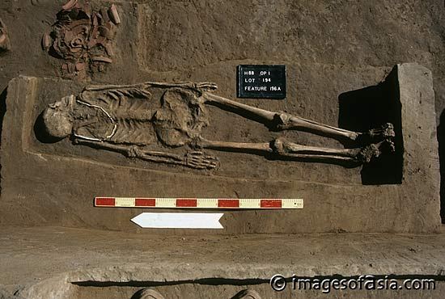
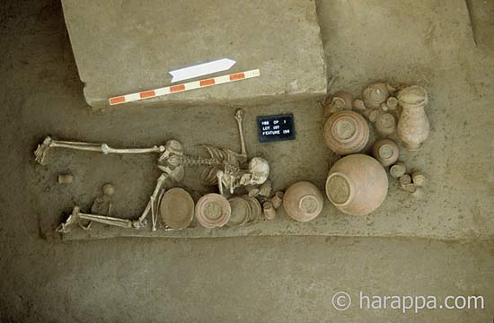
Artefact 8 - India

Slide 10
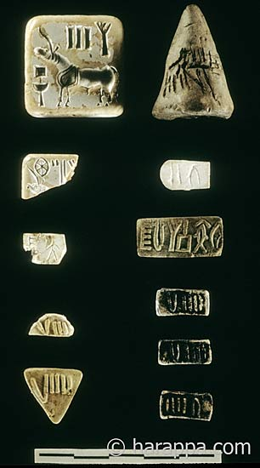
Artefact 9 - India

Slide 11
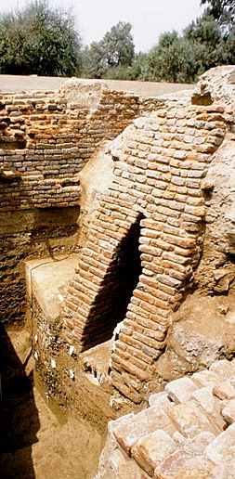
Artefact 10

Slide 12
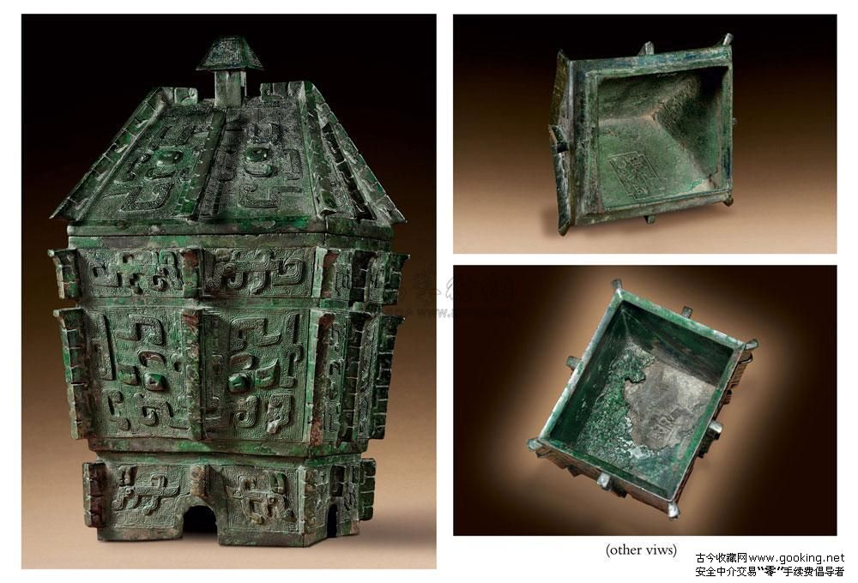
(other views) Artefact 11 - China

Slide 13
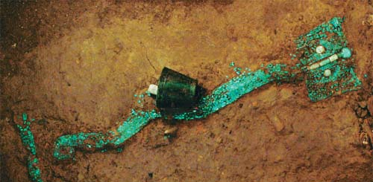
Artefact 12 - China

Slide 14
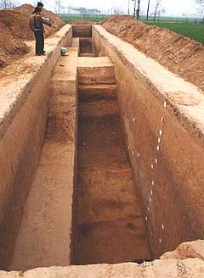
Artefact 13 – China

Slide 15
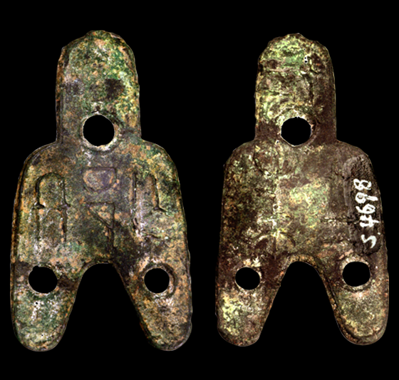
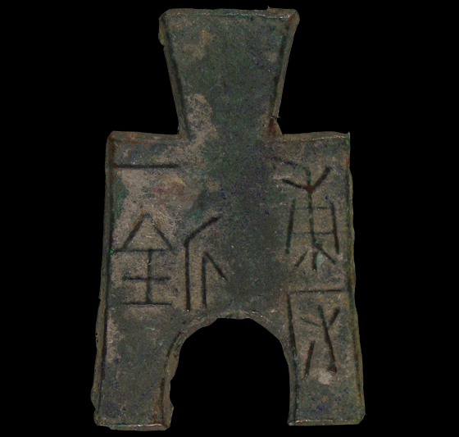
Artefact 14 - China

Slide 16
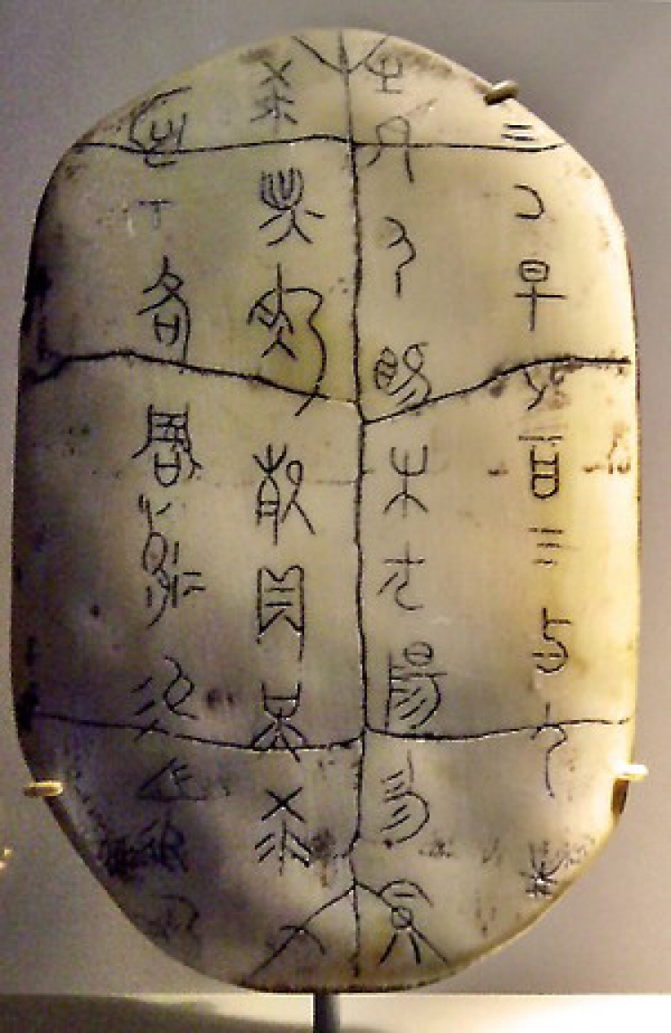
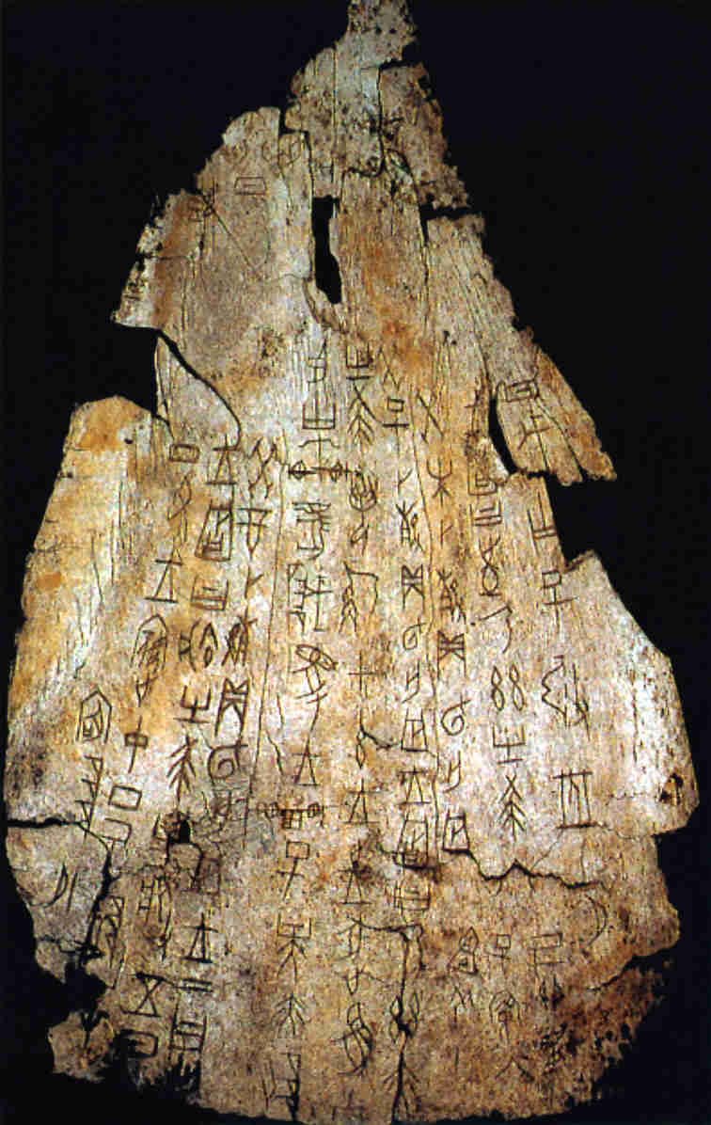
Artefact 15 - China

Slide 17
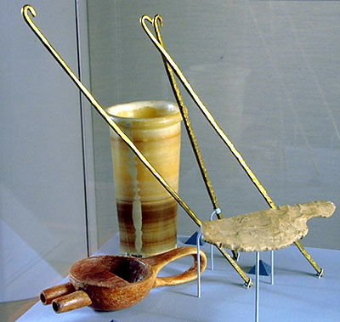
Artefact 16 - Egypt

Slide 18
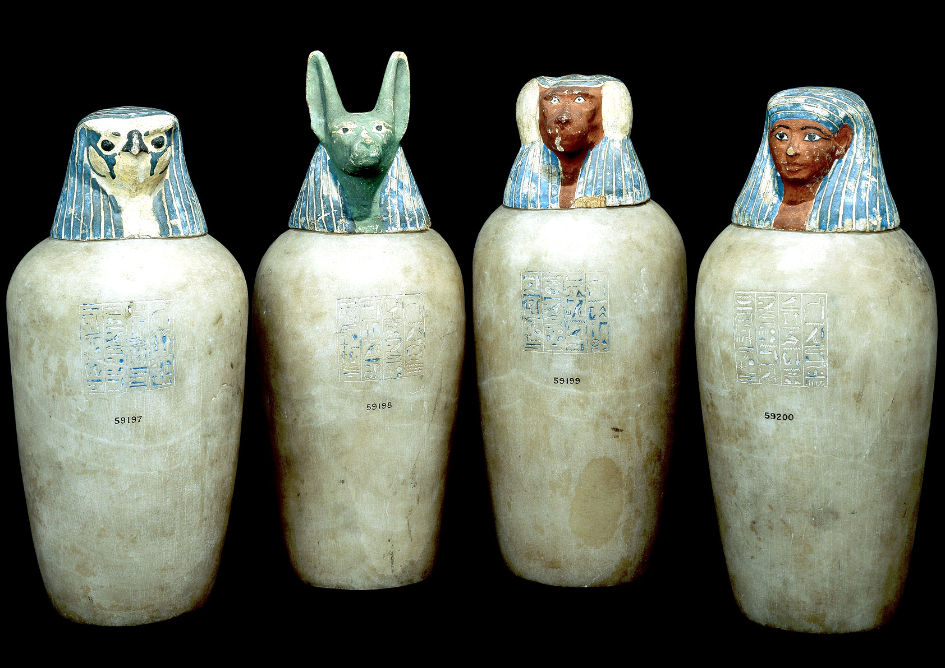
Artefact 17 - Egypt

Slide 19
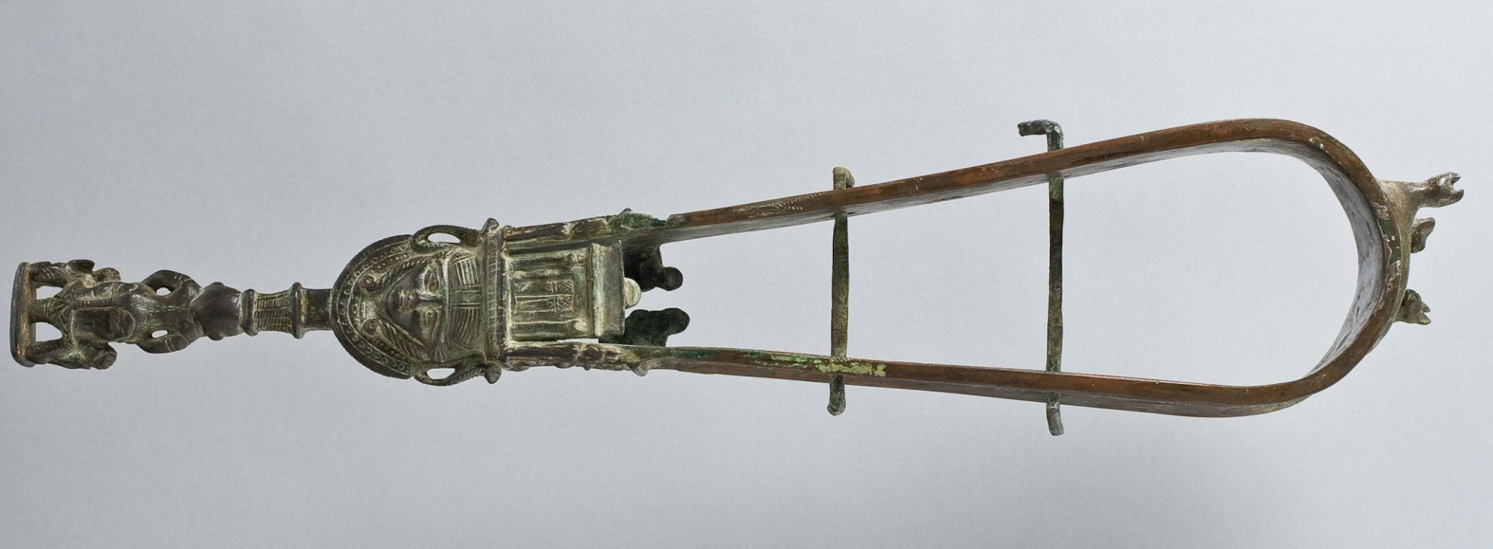
Artefact 18 - Egypt

Slide 20
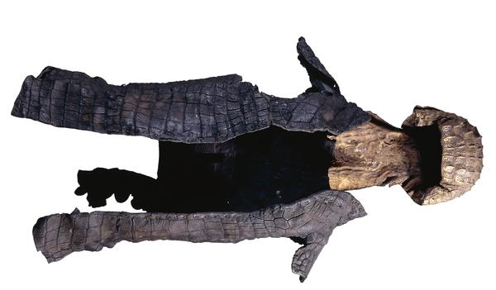
Artefact 19 - Egypt

Slide 21
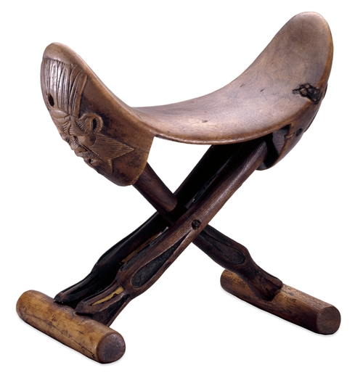
Artefact 20 - Egypt

